Slide 1

Web scraping to gain company insights
19/11/2022

Slide 2
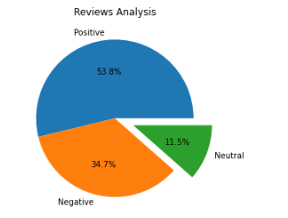
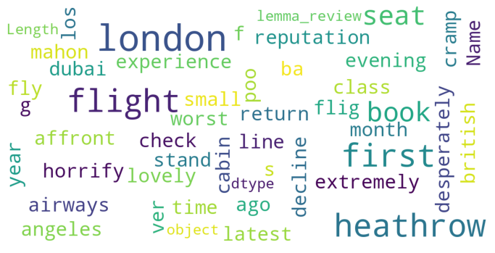
INSIGHTS FROM CUSTOMER REVIEWS
From cleaning 1000 reviews given by the customers, we obtained
Positive Reviews - 538
Negative Reviews - 347
Neutral Reviews – 115
Word cloud of keywords used in reviews

